Slide 1


Slide 2


Responsive & Adaptive Tactics for Blazor Apps
Ed Charbeneau

Slide 3


Ed Charbeneau
Author:
“Blazor: A Beginner's Guide” (free)
Тwitter:
@EdCharbeneau
Тwitch:
Twitch.tv/EdCharbeneau
Pr. Developer Advocate
Progress Software,
Telerik UI for Blazor

Slide 4

What is Responsive Design
Flexible Layout
Flexible Content
Media Queries

Slide 5
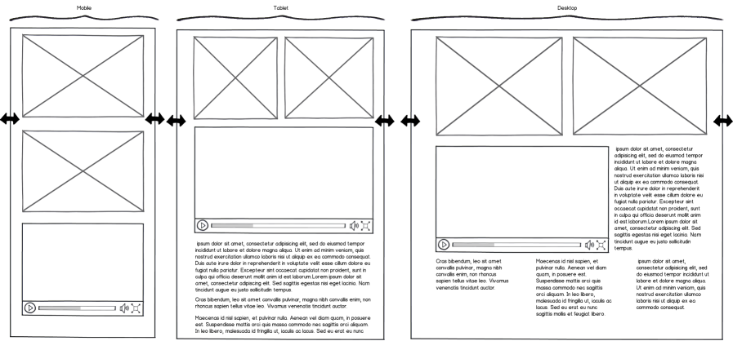
Responsive Example
tablet
desktop
mobile
desktop
mobile
desktop
Notes:
http://www.mediaqueri.es

Slide 6


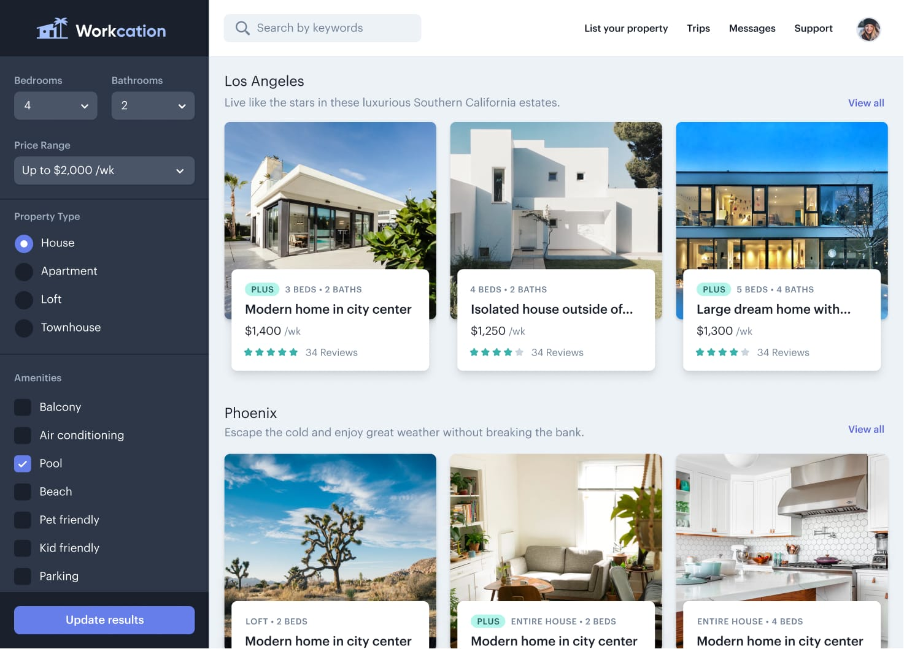

Frameworks
Bootstrap

Slide 7



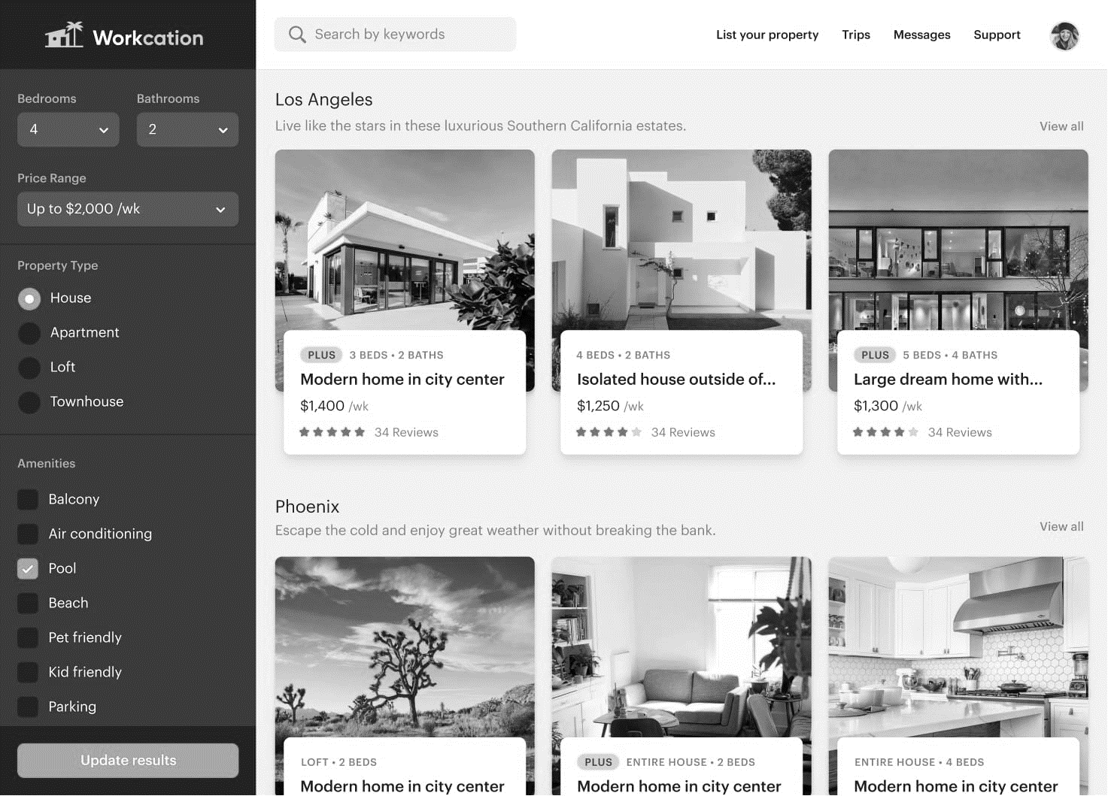
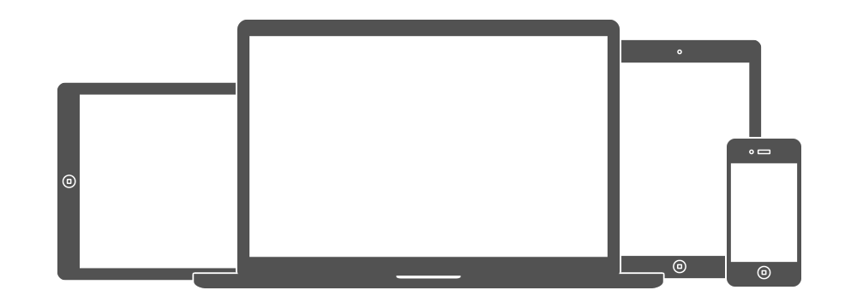
Not Necessary
Bootstrap

Slide 8
CSS Grid
a two-dimensional grid-based layout system

Slide 9
CSS Grid
a two-dimensional grid-based layout system
Column 1
Column 2
Column 3
1
2
3
4

Slide 10
CSS Grid
a two-dimensional grid-based layout system
1
Row 1
2
Row 2
3

Slide 11
CSS Flexbox
A one-direction flow layout system

Slide 12
CSS Flexbox
A one-direction flow layout system

Slide 13
CSS Flexbox
A one-direction flow layout system

Slide 14
Media Queries
/* screen size is > 768px */
@media (min-width: 768px) {
… size specific CSS here
}

Slide 15
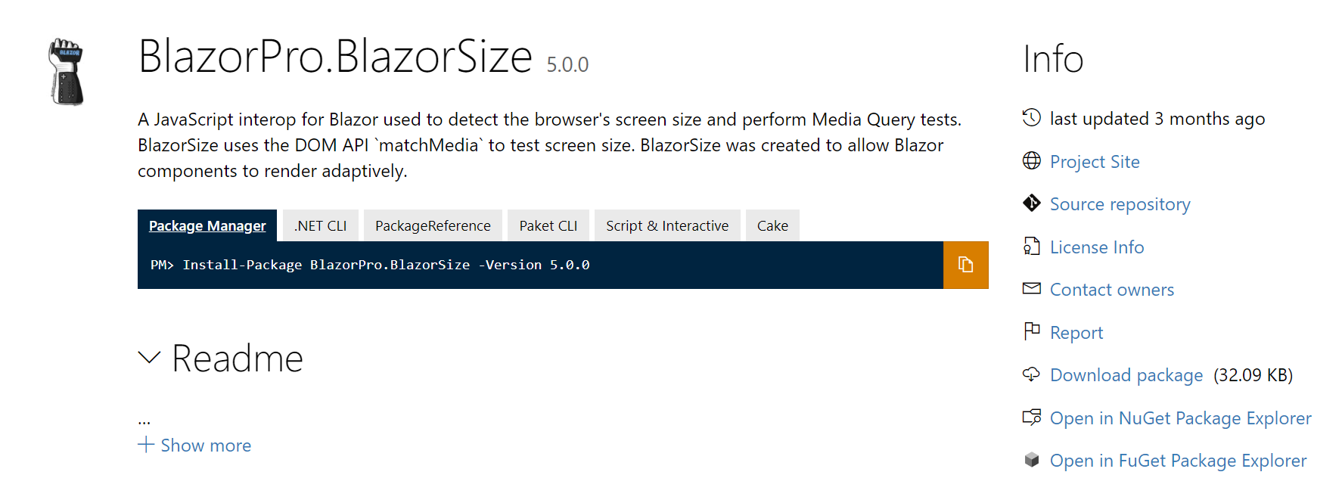
Run-time Media Query
<MediaQuery Media="@Breakpoints.SmallDown" @bind-Matches="IsSmall" />
@if (IsSmall)
{
<WeatherCards Data="forecasts"/>
}
else
{
<WeatherGrid Data="forecasts"/>
}

Slide 16

Run-time Media Query
<MediaQuery Media="@Breakpoints.SmallDown"
@bind-Matches="IsSmall" />
@if (IsSmall)
{
<WeatherCards Data="forecasts"/>
}
else
{
<WeatherGrid Data="forecasts"/>
}

Slide 17
Demo

Slide 18

Resources
EdCharbeneau.com
BlazorSize (NuGet/GitHub)
Telerik.com
Telerik.com/whitepapers Free Ebook

Slide 19

Thanks for joining!

